Slide 1
Backtesting Project
Emily Grimm, Samantha Stabile, Zachary Waits, Siddhesh Gore

Slide 2
Agenda
Our Factors
Factor Selection
Our Model
Portfolio Performance & Comparison

Slide 3
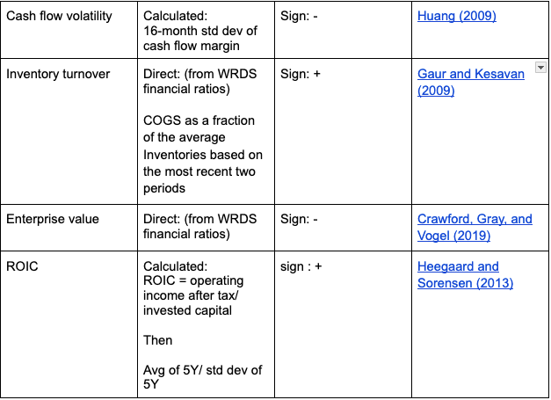
Our Factors

Slide 4
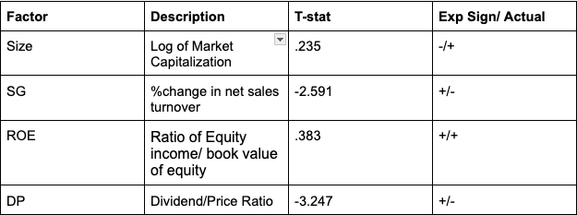
Factors Removed
Factors removed due to opposite signs and/or low t-statistics (Less than 1.5), example shown

Slide 5
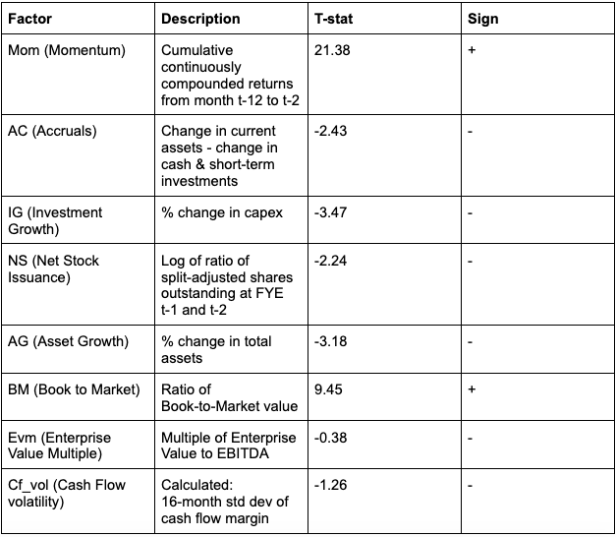
Factors Chosen
All factors chosen due to t-stat above 1.5 and/or sign was as expected

Slide 6
Factor Creation

Slide 7
Cash Flow Volatility (Huang 2009)
We would expect the sign to be negative
With increased volatility, there is a greater risk associated with the company's future CF
In turn, Investor demands higher return , which lower stock price & future returns
Calculation:
Rolling standard deviation of cash flow margins over the past 16 months

Slide 8
Inventory Turnover - Gaur & Kesavan (2009)
We would expect the sign to be positive
A higher inventory turnover leads to sales growth, therefore higher returns
Calculation:
COGS as a fraction of the average Inventories based on the most recent two periods

Slide 9
Enterprise Value - Crawford, Gray, and Vogel (2019)
We would expect the sign to be negative
Relationship is similar to size factor, as market value and enterprise value are related
As size (and enterprise value) increases, the expected future return decreases
Stocks of smaller size (lower EV) have higher expected returns
Calculation
From WRDS financial ratios - multiple of enterprise value to EBITDA

Slide 10
ROIC - Heegaard & Sorensen (2013)
We would expect the sign to be positive
ROIC is useful when determining how well a company allocates its capital to profitable projects or investments
If the ROIC is higher than the WACC, that means the company creates positive value
If the ROIC is lower than the WACC, that means the company's value is declining
Calculation:
ROIC = Net Operating Profit After Tax / Invested Capital

Slide 11
Factor Selection

Slide 12
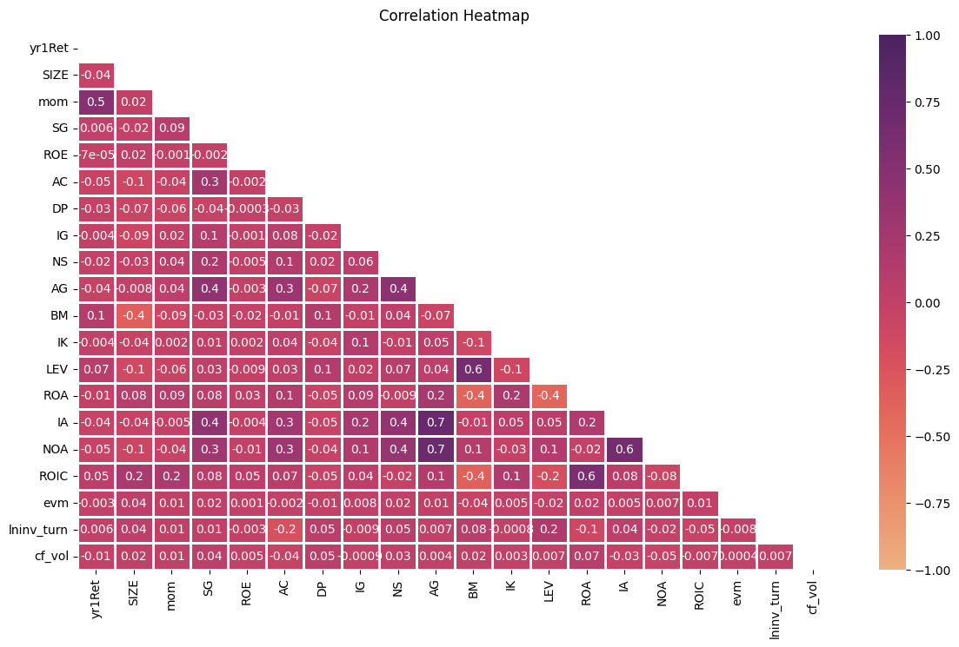
Correlation Between Factors
Most factors have low correlation with one another
Factors that had high correlation included: AG and IA, AG and NOA
Because of low correlation overall, there is assumption of no multicollinearity

Slide 13
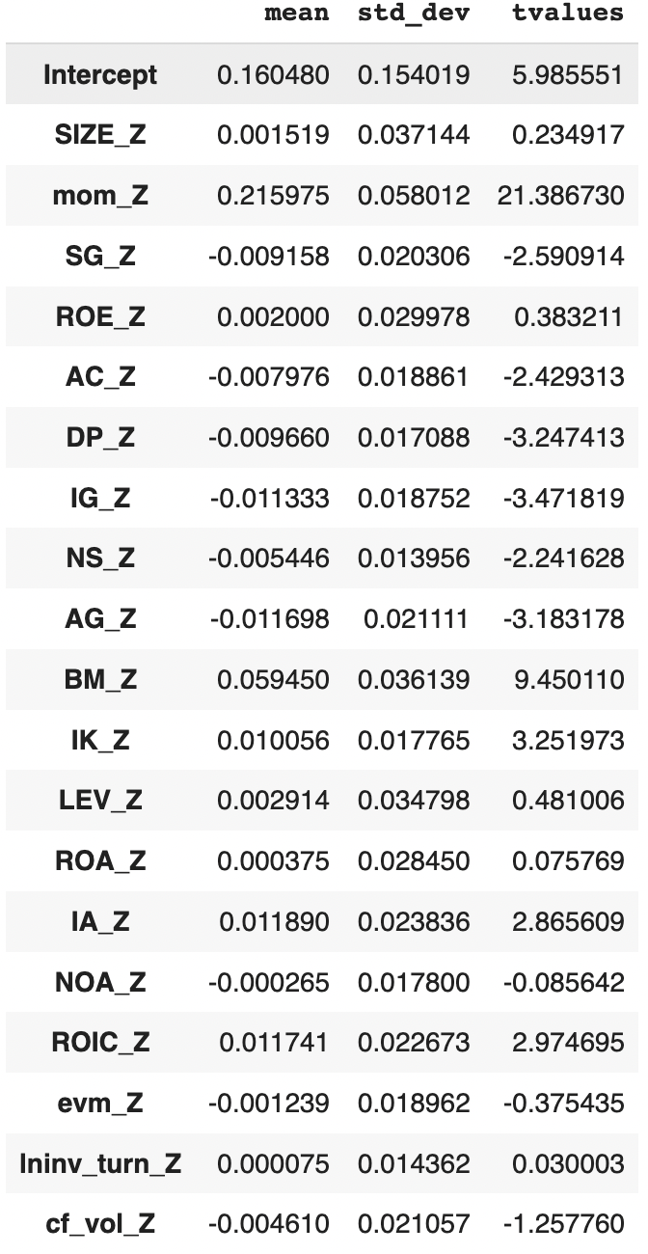
In Sample Model - Factor Premia
Criteria for Factors: T-value above 1.5 and/or sign meets theoretical expectation
Mom and BM have larger means when compared to other factors
On average, standard deviation of all factors is roughly the same

Slide 14
Portfolio Performance & Comparison

Slide 15

Portfolio’s Returns
Long portfolio generated the highest returns
Our short portfolio performed extremely well - the positive return indicates that the securities value has declined as hoped and profits were made
The relatively low returns of the Long short portfolio could be due to the diversification of the portfolio, while it reduces risk the returns can also decrease

Slide 16
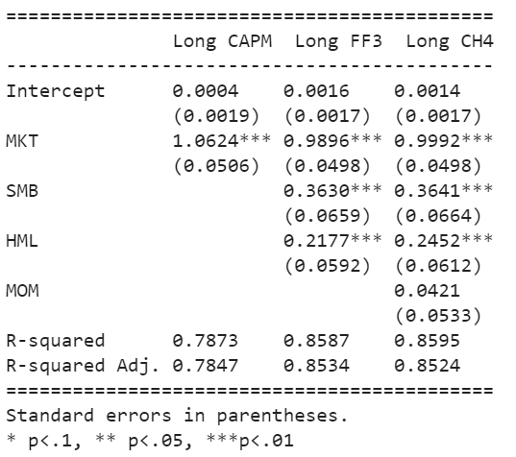
Long Portfolio Performance
Across all models, the intercept is not statistically significant
MKT is statistically significant at 1% level across all models
SMB is statistically significant at 1% level in the Long FF3 and Long CH4
HML is statistically significant at 1% level in the Long FF3 and Long CH4
MOM - not statistically significant, not a significant predictor of our model
R squared is high across all models indicating that the variation in portfolio returns can be explained by our factors

Slide 17
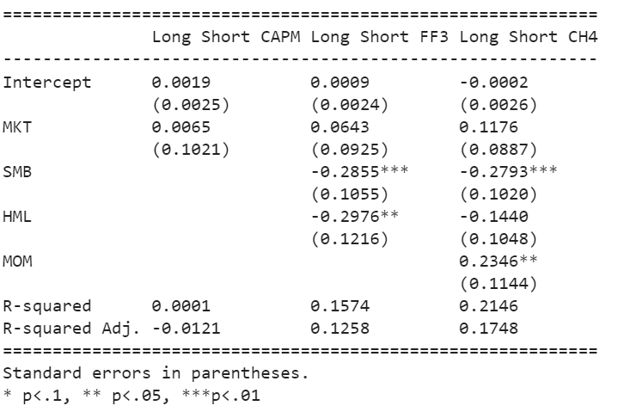
Long-Short Portfolio Performance
Across all models, the intercept is not statistically significant
MKT is not statistically significant across all models
SMB is statistically significant at 1% level in the LS FF3 and LS CH4
HML is statistically significant at 5% level in the LS FF3
MOM - is statistically significant at 5% level in the LS CH4
R squared is low across all models indicating that the variation in portfolio returns can not be explained by our factors

Slide 18

LS vs Long Only
The Long portfolio has a Sharpe ratio of almost 1, classifying its risk adjusted returns to be “good”
The Short portfolio has a Sharpe ratio of .72, meaning that it the risk adjusted returns are relatively not as good as the long portfolio
The LS Sharpe ratio is extremely low indicating that the risk adjusted returns are very poor, and this portfolio is not performing as well as the other two

